Slide 2
understand Programming Models For Big Data.

Slide 3
Popular Models
Popular Models for Big Data are:
MapReduce,
Directed Acyclic Graph,
Message Passing,
Bulk Synchronous Parallel,
Workflow.

Slide 4

MapReduce
Process Huge Amount of Data

Slide 5
MapReduce
Process Huge Amount of Data
In parallel

Slide 6
MapReduce
Process Huge Amount of Data
In parallel
On large clusters of commodity hardware

Slide 7
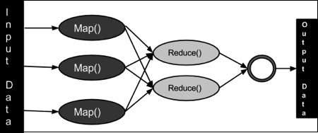
MapReduce
Key/Value pairs

Slide 8
MapReduce

Slide 9
MapReduce

Slide 10
The Algorithm
Generally MapReduce paradigm is based on sending the computer to where the data resides!
MapReduce program executes in three stages, namely map stage, shuffle stage, and reduce stage.

Slide 11
MapReduce
The MapReduce algorithm contains two important tasks
Map
Reduce

Slide 12
Advantage of MapReduce
It is easy to scale data processing over multiple computing nodes.
Under the MapReduce model, the data processing primitives are called mappers and reducers.
Decomposing a data processing application into mappers and reducers is sometimes nontrivial.

Slide 13
Advantage of MapReduce
But, once we write an application in the MapReduce form, scaling the application to run over hundreds, thousands, or even tens of thousands of machines in a cluster is merely a configuration change.
This simple scalability is what has attracted many programmers to use the MapReduce model.

Slide 14
Directed Acyclic Graph,

Slide 15
Directed Acyclic Graph
Definition
In computer science and mathematics, a directed acyclic graph (DAG) refers to a directed graph which has no directed cycles.

Slide 16
Explanation
In graph theory, a graph refers to a set of vertices which are connected by lines called edges.
In a directed graph or a digraph, each edge is associated with a direction from a start vertex to an end vertex.

Slide 17
Explanation
If we traverse along the direction of the edges and we find that no closed loops are formed along any path, we say that there are no directed cycles. The graph formed is a directed acyclic graph.
A DAG is always topologically ordered, i.e. for each edge in the graph, the start vertex of the edge occurs earlier in the sequence than the ending vertex of the edge.

Slide 18
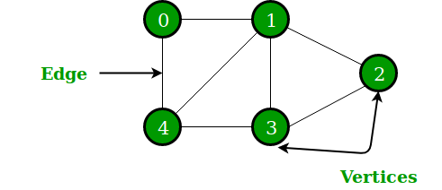
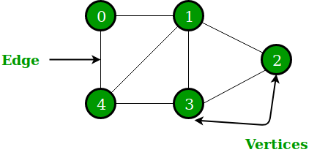
Explanation

Slide 19
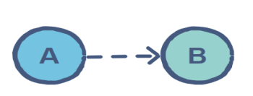
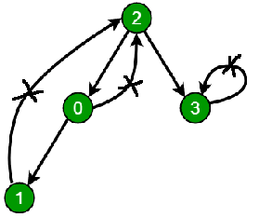
Directed Graph
No closed Loop

Slide 20
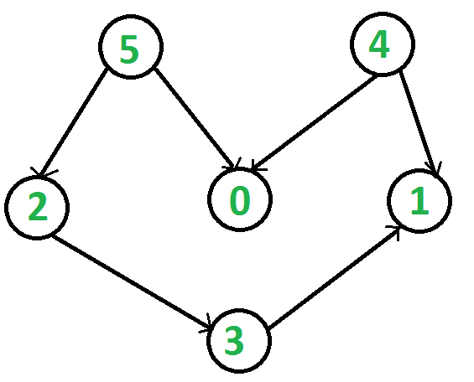
Directed Graph
Topological Order

Slide 21
Application Areas
Some of the main application areas of DAG are −
Routing in computer networks.
Job scheduling.
Data processing.
Genealogy.
Citation graphs.

Slide 22
Message Passing
Process communication is the mechanism provided by the operating system that allows processes to communicate with each other.
This communication could involve a process letting another process know that some event has occurred or transferring of data from one process to another.
One of the models of process communication is the message passing model.

Slide 23
Message Passing
Message passing model allows multiple processes to read and write data to the message queue without being connected to each other.
Messages are stored on the queue until their recipient retrieves them.
Message queues are quite useful for inter-process communication and are used by most operating systems.

Slide 24
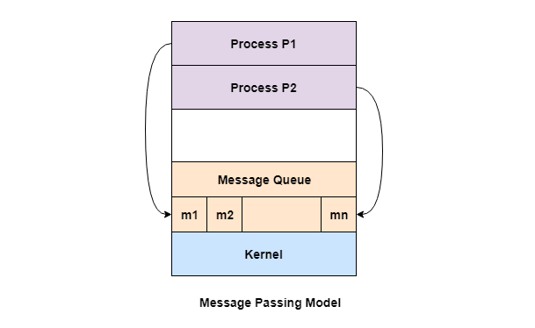
Message Passing

Slide 25
Advantages of Message Passing Mode
The message passing model is much easier to implement than the shared memory model.
It is easier to build parallel hardware using message passing model as it is quite tolerant of higher communication latencies.

Slide 26
Disadvantage of Message Passing Model
The message passing model has slower communication than the shared memory model because the connection setup takes time.

Slide 27

Bulk Synchronous Parallel

Slide 28
Bulk Synchronous Parallel
Another problem is that for graph algorithms such as DFS, BFS or Pert, MapReduce model is not satisfactory. For these scenarios, there is the BSP.

Slide 29

Bulk Synchronous Parallel

Slide 30
Bulk Synchronous Parallel

Slide 31
Bulk Synchronous Parallel

Slide 32
Five Reasons You Need a Step-by-Step Approach to Workflow Orchestration for Big Data

Slide 33
Workflow
Ingesting data.
Storing the data
Processing it.
Making data available for analytics.

Slide 34
Workflow
The approach also requires having a reliable application workflow orchestration tool that simplifies the complexity of Big Data workflows, avoids automation silos, connects processes, and manages workflows from a single point.
This allows you end to end automation, integration and orchestration of your Big Data processes, ensuring that everything is running successfully, meeting all SLAs, and delivering insights to business users on time.

Slide 35
Workflow
Cobbling together disparate automation and orchestration tools that don’t scale, may cause delays and put the entire project at risk.
Here are some of the benefits of beginning your Big Data project with application workflow orchestration in mind and using a tool that supports these steps:

Slide 36
Workflow
Improve quality, speed, and time to market.
Reduce complexity in all environments – on premises, hybrid, and multi-cloud
Ensure scalability and reduce risk
Achieve better Integration
Improve reliability
Looking ahead

Slide 37
Workflow
Improve quality, speed, and time to market
Reduce complexity in all environments – on premises, hybrid, and multi-cloud.
Ensure scalability and reduce risk
Achieve better Integration
Improve reliability
Looking ahead

Slide 38
Workflow
Improve quality, speed, and time to market
Reduce complexity in all environments – on premises, hybrid, and multi-cloud
Ensure scalability and reduce risk.
Achieve better Integration
Improve reliability
Looking ahead

Slide 39
Workflow
Improve quality, speed, and time to market
Reduce complexity in all environments – on premises, hybrid, and multi-cloud
Ensure scalability and reduce risk
Achieve better Integration.
Improve reliability
Looking ahead

Slide 40
Workflow
Improve quality, speed, and time to market
Reduce complexity in all environments – on premises, hybrid, and multi-cloud
Ensure scalability and reduce risk
Achieve better Integration
Improve reliability.
Looking ahead

Slide 41
Workflow
Improve quality, speed, and time to market
Reduce complexity in all environments – on premises, hybrid, and multi-cloud
Ensure scalability and reduce risk
Achieve better Integration
Improve reliability
Looking ahead.

